Slide 1
Growth Team Sales Dashboard — Q2 2026
Generated May 12, 2026
Q2 YTD | Apr 1 – May 12, 2026 | Generated May 12, 2026 | Source: HubSpot + Metabase
$31.8M
77%
23,808
9
Team GWP Q2 YTD | Proj. $68.8M
Activity Compliance Q2
Submissions Q2 YTD
Net New Agencies Appointed
Pacing 113% of Q1 Final
AT RISK
Pacing 112% of Q1 Final
38% of Goal | 9 / 24 target
Q2 MIX
$20.5M
$6.1M
$5.2M
New Business (65%)
Renewals (19%)
Endorsements (16%)
$60.7M
48%
45,952
5
Q1 FINAL
GWP
Activity
Submissions
Agencies Appointed
TEAM TRENDS Q1 → Q2
REP SPOTLIGHTS
▲
GWP pacing 113% of Q1 Final • $31.8M YTD → projected $68.8M
★
D.Janssen — Q2 GWP leader $10.3M YTD
▼
Q2 Gap: need $5.7M/wk to close $39.6M shortfall • current pace $5.3M/wk • 7 wks remaining
★
D.Janssen — Highest activity compliance 160%
▲
Team activity Q1 48% → Q2 77% (+29pp)
▲
A.Berry-Smith — Best Q2 GWP trajectory +397% YOY (pace-adj)
▲
Submissions pacing 112% of Q1 • 23,808 YTD → projected 51,584
⚠
A.Berry-Smith — Activity at 18% — coaching focus
▲
Net New Agencies Q1 5 → Q2 9 YTD (team goal: 24/quarter)
Notes:
PURPOSE
The opening snapshot — four KPI tiles that tell you at a glance whether the team is ahead, on pace, or behind for Q2.
WHAT TO LOOK FOR
- Team GWP Q2 YTD: Is the pace badge green (on track to beat Q1)? Amber means we're close but need to accelerate. Red means we're trending below last quarter.
- Activity Compliance %: Are reps hitting their weekly call and meeting targets? This is the most controllable metric — low compliance is an early warning sign.
- Submissions Q2 YTD: More submissions now = more revenue in 60-90 days. Watch for YOY growth or decline. NOTE: this figure only counts submissions from agencies assigned to Growth Team reps — it will be lower than the company-wide total.
- Net New Agencies: Goal is 4 per BDM per quarter (24 team total). Any rep at zero by mid-quarter needs a coaching conversation.
- Q2 MIX strip (purple): breaks Q2 GWP into New Business / Renewals / Endorsements with $ amount and % of total. If endorsements lead, the GWP is being carried by existing-book activity rather than new wins.
- Q1 Final strip (gray): Q1 full-quarter actuals for each KPI — use as the benchmark. Q2 should be equal to or better than Q1.

Slide 2
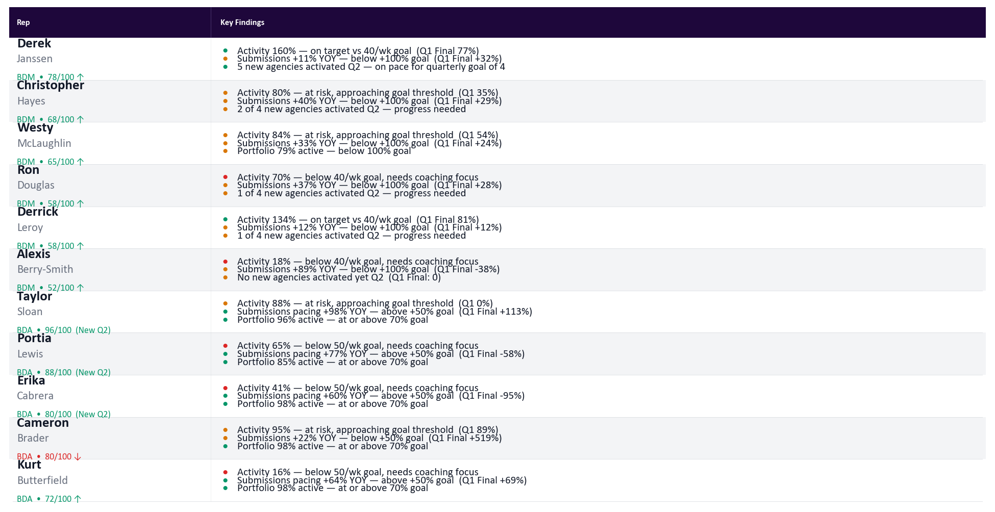
Individual Rep Key Findings — Q2 2026
Generated May 12, 2026
Gap: need $5.7M/wk ($39.6M shortfall, 7 wks left) | Q1→Q2 | Apr 1–May 12 | Ranked by composite OKR score | Values pace-adjusted
Notes:
PURPOSE
This slide gives a one-row-per-rep narrative summary so you can talk through each person's Q2 story without flipping between other slides.
WHAT TO LOOK FOR
- Reps are sorted by composite OKR score — highest performers at the top.
- Each rep's row has three bullet points covering their biggest strength, their biggest gap, and a specific action item.
- Green badge = on target across all OKRs. Amber = at risk on at least one. Red = behind on two or more.
- Pay close attention to any rep where Activity is falling AND Subs YOY is also declining — that's a compounding problem.
- The header bar shows the team's overall Q2 GWP gap: how much revenue per week the team needs to close to hit the quarterly goal.

Slide 3
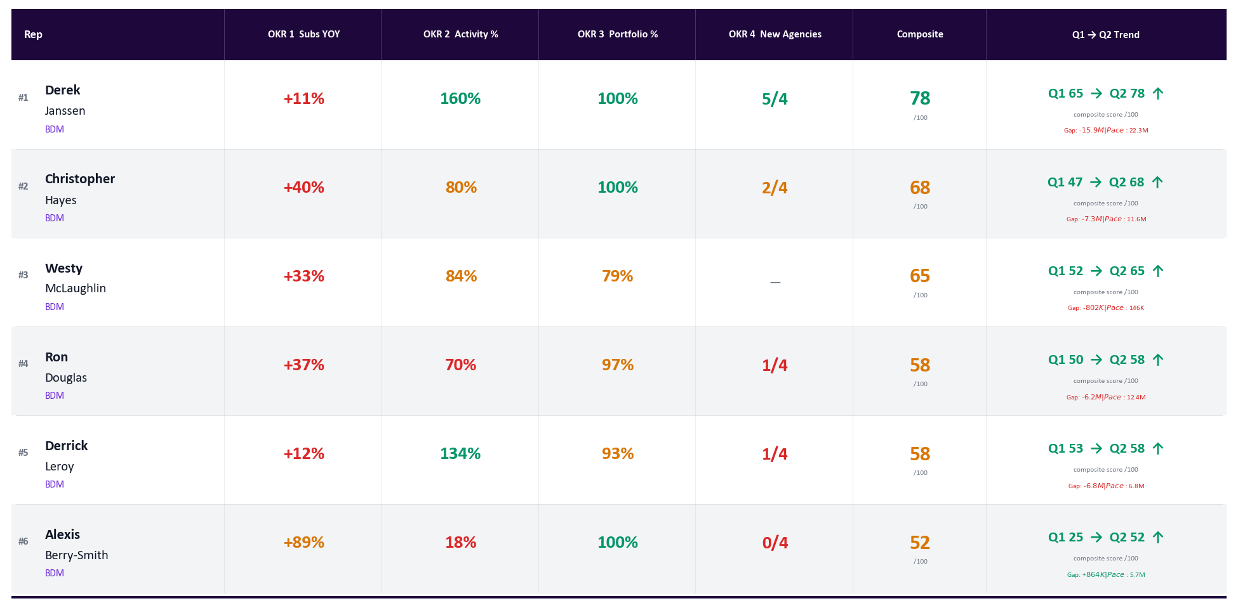
BDM Performance Matrix — Q2 2026
Generated May 12, 2026
Q2 2026 YTD (Apr 1–May 12) | Green = on target | Amber = at risk | Red = behind | Goal: ≥40 acts/wk | Ranked by composite OKR score
Notes:
PURPOSE
This slide ranks BDMs head-to-head across all four Q2 goals so you can immediately see who is driving and who needs support.
WHAT TO LOOK FOR
- Overall composite score: reps are sorted highest to lowest — the top performers are on the left, those falling behind are on the right.
- Color coding: Green = on or above target, Amber = within reach but at risk, Red = behind and needs attention now.
- Arrows show Q1-to-Q2 direction — a rep with a red score but an upward arrow is improving; a green score with a downward arrow is a warning.
- All numbers are pace-adjusted for the 42 days elapsed so far in Q2, so you're comparing apples to apples.
- Any rep who is red on both Activity and Subs YOY at the same time is the highest coaching priority.
SCORING GUIDE
- OKR 1 (Subs YOY): goal is +100% over last year. Score is 0-100 based on how close they are.
- OKR 2 (Activity): goal is 40 calls + meetings per week. Score is % of weeks at goal.
- OKR 3 (Portfolio Active): goal is 100% of assigned agencies submitting. Active = any 2026 submission on the agency from any source. Score is active agencies / total portfolio.
- OKR 4 (New Agencies): goal is 4 true new appointments per quarter. Counts NNA-pipeline Activated-Won deals whose name starts with "Appointed - " (excludes "Already appointed", "No deal received", "Duplicate", and pending paperwork tags).

Slide 4
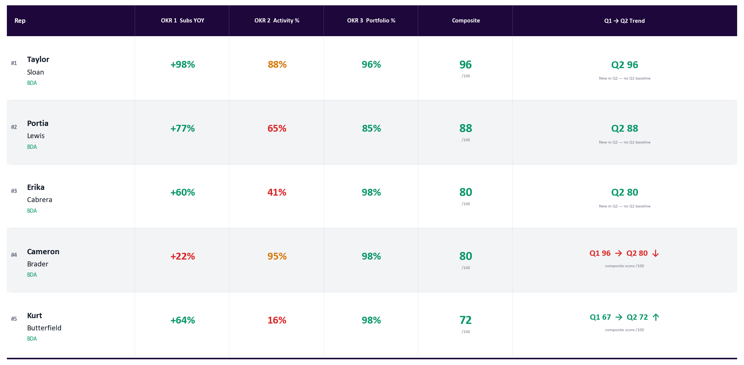
BDA Performance Matrix — Q2 2026
Generated May 12, 2026
Q2 2026 YTD (Apr 1–May 12) | Green = on target | Amber = at risk | Red = behind | Goal: ≥50 acts/wk | Ranked by composite OKR score
Notes:
PURPOSE
Same layout as the BDM matrix but scoped to BDAs, who have different goals reflecting their development stage.
WHAT TO LOOK FOR
- BDA goals are lower than BDM goals by design: Subs +50% YOY (vs +100%), Activity 50 acts/wk (vs 40), Portfolio 70% active (vs 100%). Green/Amber/Red thresholds are calibrated accordingly.
- BDAs do not have an OKR 4 (new agencies) — their composite is based on three OKRs only.
- Arrows show Q1-to-Q2 trend — early Q2 momentum matters most for newer reps.
- Any BDA who is red on Activity in Q2 is the most urgent coaching conversation, since activity volume is the foundation everything else builds on.
- Note: Some BDAs' Q2 accountability started mid-April — gray cells indicate weeks before their quota start date.

Slide 5
Activity Dashboard — Q2 2026 | BDMs | Calls + Meetings
Generated May 12, 2026
Q2 YTD | Apr 1–May 12 | BDMs Only | Goal: 40 acts/wk | Emails excluded
Rep
Apr 6-12
Apr 13-19
Apr 20-26
Apr 27-May 3
May 4-10
May 11-12
Avg %
Derek Janssen
89
58
67
63
43
6
160%
Ron Douglas
17
43
34
47
0
2
70%
Christopher Hayes
39
42
25
40
15
8
80%
Derrick Leroy
50
48
65
51
54
12
134%
Westy McLaughlin
46
29
28
39
25
7
84%
Alexis Berry-Smith
0
0
4
0
32
22
18%
Rep
Role
Calls
Meetings
Total
Avg/Wk
% to Goal
Q2 Subs
Q2 Quotes
Q2 Binds
Bind %
Derek Janssen
BDM
334
47
381
64.0
160%
5472
4105
415
7.6%
Ron Douglas
BDM
124
22
146
28.2
70%
4213
3017
238
5.6%
Christopher Hayes
BDM
171
11
182
32.2
80%
2636
1987
272
10.3%
Derrick Leroy
BDM
318
11
329
53.6
134%
2470
1913
197
8.0%
Westy McLaughlin
BDM
175
11
186
33.4
84%
147
94
6
4.1%
Alexis Berry-Smith
BDM
52
6
58
7.2
18%
1400
977
110
7.9%
Notes:
PURPOSE
This slide shows week-by-week activity discipline for BDMs — the single most controllable input to revenue performance.
WHAT TO LOOK FOR
- Goal is 40 calls and meetings combined per week, per BDM. Emails do not count.
- Color per cell: Green = at or above 40. Amber = 30-39 (75-99% of goal). Red = below 30. Gray = zero activity logged.
- Look for consecutive red or gray weeks — that's a pattern, not a one-off, and needs a direct conversation.
- The Avg % column on the right is the most important number: it tells you each rep's Q2 compliance rate at a glance.
- A rep with a high Avg % is building pipeline. A rep with a low Avg % is not, regardless of what their GWP looks like right now.
- BDA Activity Dashboard is on the next slide.

Slide 6
Activity Dashboard — Q2 2026 | BDAs | Calls + Meetings
Generated May 12, 2026
Q2 YTD | Apr 1–May 12 | BDAs Only | Goal: 50 acts/wk | Emails excluded
Rep
Apr 6-12
Apr 13-19
Apr 20-26
Apr 27-May 3
May 4-10
May 11-12
Avg %
Cameron Brader
31
58
38
57
53
6
95%
Erika Cabrera
21
39
14
8
41%
Portia Lewis
33
34
53
10
65%
Taylor Sloan
48
58
54
15
88%
Kurt Butterfield
0
0
1
0
39
13
16%
Rep
Role
Calls
Meetings
Total
Avg/Wk
% to Goal
Cameron Brader
BDA
266
9
275
47.4
95%
Erika Cabrera
BDA
76
6
82
20.5
41%
Portia Lewis
BDA
124
6
130
32.5
65%
Taylor Sloan
BDA
167
8
175
43.8
88%
Kurt Butterfield
BDA
51
2
53
8.0
16%
Notes:
PURPOSE
Same activity heatmap as the BDM slide but for BDAs, who have a higher weekly goal reflecting their outbound-focused role.
WHAT TO LOOK FOR
- BDA goal is 50 calls and meetings per week. Green = at or above 50. Amber = 37-49. Red = below 37. Gray = zero.
- Some BDAs have gray cells in early April — that is expected, as their Q2 accountability started the week of April 20.
- BDAs who are consistently amber or red in their first full weeks of accountability need immediate attention — early habits set the trajectory for the quarter.
- The summary table below the heatmap shows total calls, meetings, and overall % to goal for each BDA.
- BDM Activity Dashboard is on the previous slide.

Slide 7
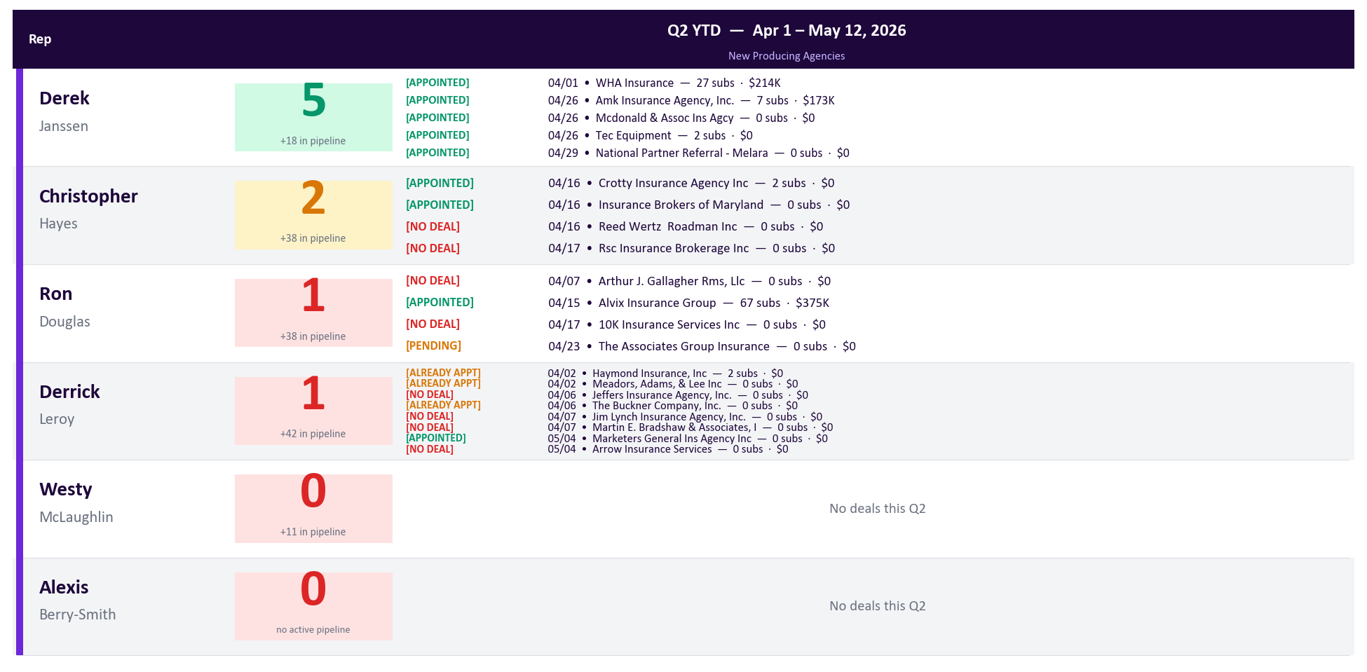
New Producing Agencies | Q2 YTD
Generated May 12, 2026
BDMs Only | All Activated-Won NNA deals shown w/ status tag + close date · OKR4 count = APPOINTED only · Goal: 4 per BDM/quarter | Q1 reference in Appendix
Notes:
PURPOSE
This slide tracks the team's most important growth metric — how many brand-new agencies each BDM has brought into production this quarter.
WHAT TO LOOK FOR
- Goal is 4 new activated agencies per BDM per quarter (20 team total). This is the pipeline for future GWP.
- Green = at or above goal. Amber = 2-3 agencies (partial progress). Red = 0-1, which is a red flag at any point in the quarter.
- The agency names listed under each rep are the new accounts — these are conversation starters for the meeting ("who is Derek's new agency? How did that come together?").
- We are 42 days into a 91-day quarter. A rep with 0 new agencies by day 30+ needs a pipeline review.
- Q1 final reference is in the Appendix — compare Q1 actuals to Q2 progress to spot reps who are improving vs. repeating a miss.

Slide 8
Account Health & Agency Engagement
Generated May 12, 2026
Active vs Dormant | BDMs + BDAs | Active = any 2026 submission on the agency | Dormant = zero 2026 submissions | Never Active = no submissions in 2025 or 2026
Rep
Portfolio
Active
Dormant
No Act.
Eng.%
GWP/Ag
Bind %
React. $
Q1 GWP
Q1 Renew
Q1 Canc
Q1 Subs
Q1 Binds
Q2 Subs
Q2 Binds
Q2 GWP
Q2 Renew
Q2 Canc
No Q2
Derek Janssen
53
53
0
0
100%
$441K
5.3%
$0
$23.4M
$4.1M
$9.6M
12526
663
5472
415
$10.3M
$3.3M
$3.2M
16
Christopher Hayes
45
45
0
0
100%
$261K
8.4%
$0
$11.7M
$1.7M
$4.5M
4809
406
2636
272
$5.4M
$830K
$2.2M
31
Ron Douglas
35
34
1
0
97%
$285K
4.4%
$285K
$9.7M
$818K
$4.0M
7985
353
4213
238
$5.7M
$982K
$2.8M
20
Derrick Leroy
30
28
0
2
93%
$275K
6.1%
$0
$7.7M
$738K
$3.9M
5078
311
2470
197
$3.2M
$483K
$1.2M
7
Alexis Berry-Smith
22
22
0
0
100%
$64K
3.2%
$0
$1.4M
$407K
$388K
959
31
1400
110
$2.6M
$118K
$1.2M
9
Westy McLaughlin
14
11
0
3
79%
$25K
5.8%
$0
$275K
$44K
$154K
257
15
147
6
$67K
$15K
$44K
7
BDAs — Business Development Associates (goal: ≥70% portfolio active)
Kurt Butterfield
42
41
1
0
98%
$70K
1.6%
$70K
$2.9M
$179K
$1.3M
5782
94
3054
77
$2.0M
$74K
$561K
14
Cameron Brader
48
47
1
0
98%
$52K
1.5%
$52K
$2.5M
$154K
$1.1M
7330
112
712
36
$970K
$187K
$30K
21
Taylor Sloan
26
25
1
0
96%
$29K
3.0%
$29K
$728K
$65K
$203K
670
20
436
15
$280K
$61K
$243K
2
Portia Lewis
53
45
7
1
85%
$9K
2.0%
$63K
$406K
$44K
$202K
492
10
1190
27
$757K
$24K
$158K
8
Erika Cabrera
42
41
1
0
98%
$2K
7.8%
$2K
$72K
$18K
$30K
64
5
2078
41
$513K
$0
$188K
16
Unassigned
839
569
270
—
68%
$64K
3.0%
$17.3M
$36.5M
$6.2M
$17.0M
36610
1108
16453
—
—
—
—
—
BDMs
199 portfolio · 193 active · 1 dormant · 5 never active
BDAs
211 portfolio · 199 active · 11 dormant · 1 never active
TEAM
410 portfolio · 392 active · 96% engaged · Reactivation: $1.9M
Notes:
PURPOSE
This slide answers one question: how well is each rep actually working their assigned book? An agency that is assigned but not submitting is a missed opportunity — this slide quantifies that gap in dollars.
WHAT TO LOOK FOR
- Eng. % (Engagement): this is the most important column. Green = 75%+ of assigned agencies actively submitting. Amber = 50-74%. Red = below 50%. A rep with low engagement has dormant relationships that should be producing revenue.
- Reactivation $: the estimated revenue sitting in dormant agencies if they could be re-engaged to average productivity. Any large number here is a coaching talking point.
- Q1 Cancel vs Q1 Renew: if cancellations are running close to or exceeding renewals for a rep, that rep has a retention problem that will hurt Q2 GWP.
- Q2 Subs (early signal): are reps' agencies already submitting in Q2? Low Q2 subs early in the quarter = a slow start is coming.
- No Q2 Contact: agencies in the rep's portfolio with no HubSpot activity logged since Apr 1. Red = any uncontacted accounts exist.
COLUMN GUIDE
- Portfolio: total agencies assigned to this rep.
- Active: agencies that submitted at least once in Q1 2026.
- Dormant: assigned to this rep but have NOT submitted any quotes in Q1 2026 — regardless of prior year history.
- Never Act.: assigned in their portfolio but never submitted any quotes in Q1 2026.
- Eng. %: Active divided by Portfolio — the engagement rate.
- Avg GWP/Ag: Q1 premium divided by active agencies — measures depth of relationships.
- Bind %: bound policies divided by submissions — quality of submissions.
- Reactivation $: estimated revenue if dormant agencies match average productivity.
- Q1 GWP / Q1 Renew / Q1 Cancel: premium written, renewed, and cancelled in Q1 2026.
- Q1 Subs / Q1 Binds / Q2 Subs / Q2 Binds: submission and bind counts per period. Only counts agencies assigned to this rep — the team total will be lower than the company-wide figure because unassigned agencies are excluded.
- No Q2 Contact: count of assigned agencies with no HubSpot activity (call, meeting, note, email) recorded since April 1, 2026.

Slide 9
Agency Tier Breakdown
Generated May 12, 2026
Tier 1 = highest value · Tier 5 = lowest · Untiered = not yet classified in HubSpot · Top 3 Conc% = top 3 agencies as % of rep Q1 GWP
Rep
Tier 1
Tier 2
Tier 3
Tier 4
Tier 5
Untiered
Total
Top 3 Conc%
Top Agency
Top Agency GWP
Derek Janssen
18
35
0
0
0
0
53
31%
Safeline Insurance Agency, …
$3.3M
Christopher Hayes
10
35
0
0
0
0
45
53%
Commercial Trucking Insuran…
$2.6M
Ron Douglas
5
28
2
0
0
0
35
75%
USA SPECIALTY INSURANCE/DBA…
$4.3M
Derrick Leroy
8
14
3
1
1
3
30
68%
American Fleet Insurance
$2.5M
Kurt Butterfield
0
0
13
27
1
1
42
71%
Justin Robert Insurance Age…
$1.1M
Cameron Brader
0
0
7
41
0
0
48
26%
Regis Insurance Services, I…
$232K
Alexis Berry-Smith
7
15
0
0
0
0
22
97%
Alex Rue Insurance Agency, …
$661K
Taylor Sloan
0
0
7
15
3
1
26
71%
Fredrick B. Roberson Insura…
$198K
Portia Lewis
0
0
7
32
14
0
53
100%
Vantage Ins LLC
$396K
Westy McLaughlin
1
4
0
5
2
2
14
84%
ACRISURE LLC dba CLG Insura…
$106K
Erika Cabrera
0
0
3
33
3
3
42
100%
Dubeh Insurance Inc
$26K
Notes:
PURPOSE
This slide shows how each rep's book of business is structured by agency quality tier, revealing whether reps are over-reliant on a handful of top accounts or have a healthy spread.
WHAT TO LOOK FOR
- Top 3 Conc%: if a rep's top three agencies make up more than 60% of their Q1 GWP, that's a concentration risk — losing one of those agencies would significantly hurt their numbers. Red = 60%+, Amber = 40-59%, Green = below 40%.
- Tier 1 count: reps with more Tier 1 agencies have higher-value relationships. Compare Tier 1 counts across the team.
- Untiered count: agencies without a tier assigned haven't been fully onboarded in our system. High untiered numbers mean incomplete account data.
- Top Agency and Top Agency GWP: the single biggest account for each rep — useful to know going into any rep conversation.
COLUMN GUIDE
- Tier 1-5: count of agencies at each quality tier (1 = highest value, 5 = lowest).
- Untiered: agencies assigned to the rep but not yet classified by tier.
- Total: total agencies in the rep's portfolio.
- Top 3 Conc%: percentage of the rep's Q1 GWP coming from their top three agencies.
- Top Agency / Top Agency GWP: the single agency generating the most Q1 revenue for that rep.

Slide 10
Strategic Assessment — Q2 2026
Generated May 12, 2026
What the data tells us | Where we are strong | Where the gaps are | What to do next
ON TRACK
GWP GROWTH (YOY)
Q2 pace-adj +73.6% YOY (Q1 Final: -10.8%) — at/above 20% target.
→ Protect the renewal book. Identify top agencies and replicate across the portfolio.
SUBMISSION GROWTH (YOY)
Q1 subs +27.6% YOY — above 10% target. Pipeline input expanding.
→ Sub growth leads production by 60-90 days — sustained growth should lift Q3.
PORTFOLIO ENGAGEMENT
96% of 410 assigned agencies active in Q1 — healthy.
→ Deepen share-of-wallet with active agencies.
Q2 QUOTA PACING
BDM avg Q2 quota pace 113% — on track. Above quota: R.Douglas, A.Berry-Smith.
→ Ensure pipeline stays 2x+ to sustain close rate through June.
NEW VS. RENEWAL MIX
Q1 new biz $39.7M (65%) vs renewals $8.3M (14%) — healthy growth engine.
→ Ensure onboarding quality keeps new agencies submitting in Q2.
BDA EARLY SIGNAL
BDA Q2 YTD: $4.5M GWP / 7470 subs (accountability started Apr 20) — traction confirmed.
→ Support with agency introductions. Monitor weekly — ramp trajectory locks in around week 6.
WATCH
ACTIVITY % TO GOAL
Q2 activity 77% of goal (Q1: 48%). Under 75%: R.Douglas, A.Berry-Smith, K.Butterfield.
→ No rep below 75% for 2 consecutive weeks. Coach laggards individually.
PIPELINE COVERAGE
Team pipeline coverage 1.7× goal. Below 2× healthy threshold.
→ Reps need more open quotes or better follow-up on stale ones.
GWP CONCENTRATION RISK
D.Janssen = 38% of team Q1 GWP $60.7M — high dependency.
→ Accelerate 2nd/3rd-tier BDM development. Protect this rep’s book from reassignment.
GAP — ACTION REQUIRED
SUBMISSION HIT RATIO
Q1 hit ratio 3.8% vs 5.4% prior year — well below 10% target.
→ Root cause by rep and agency. Likely pricing fit or insufficient follow-through.
AGENCY COVERAGE
70.0% of submissions (57,834) have no rep — revenue orphaned.
→ Assign immediately. Sort by volume — highest-volume agencies get priority.
CANCELLATION ACTIVITY
Q1 cancellations $25.4M (42% of gross GWP) — high fleet churn.
→ Audit by rep. A few large fleet accounts likely drive the bulk.
6 ON TRACK | 3 WATCH | 3 GAPS || No reps fully on track across all Q2 dimensions | 7 reps require attention (below Q2 quota or activity)
Notes:
PURPOSE
This is the automated "so what" slide — it reads all the data and converts it into plain-English findings and recommended actions, so you always have something specific to say in the meeting.
WHAT TO LOOK FOR
- Start with the RED rows — those are the issues that need immediate action. Read the Finding column to understand what's happening, then read the Action column to know what to do about it.
- AMBER rows are watch items — not on fire yet, but trending the wrong way. Assign owners and check next week.
- GREEN rows are the wins — worth calling out briefly to reinforce what's working.
- Bottom strip shows the overall scorecard: how many of the 7 key dimensions are green, amber, or red, and how many reps are on track vs. need attention.
THE 7 DIMENSIONS (in plain English)
- GWP Growth (YOY): is the team writing more premium than this time last year? Target is +20%. Green = yes, on track. Red = declining.
- Activity Compliance: are reps making their weekly call and meeting targets? The most controllable indicator. Red here is a management action item, not just a data point.
- Submission Hit Ratio: of every quote we submit, how many bind? This is a quality signal — too low means we're submitting bad risks or pricing poorly. Based on Q1 final.
- Submission Growth (YOY): are we sending more quotes than last year? Today's submissions are next quarter's GWP.
- Portfolio Engagement: what % of assigned agencies are actively submitting? Low engagement = untapped book.
- Agency Coverage: are there agencies submitting with no rep assigned? Unowned relationships are revenue at risk.
- Pipeline Coverage: does the team have enough pipeline to hit Q2 goals? Green = 2x+ monthly goal covered.

Slide 11
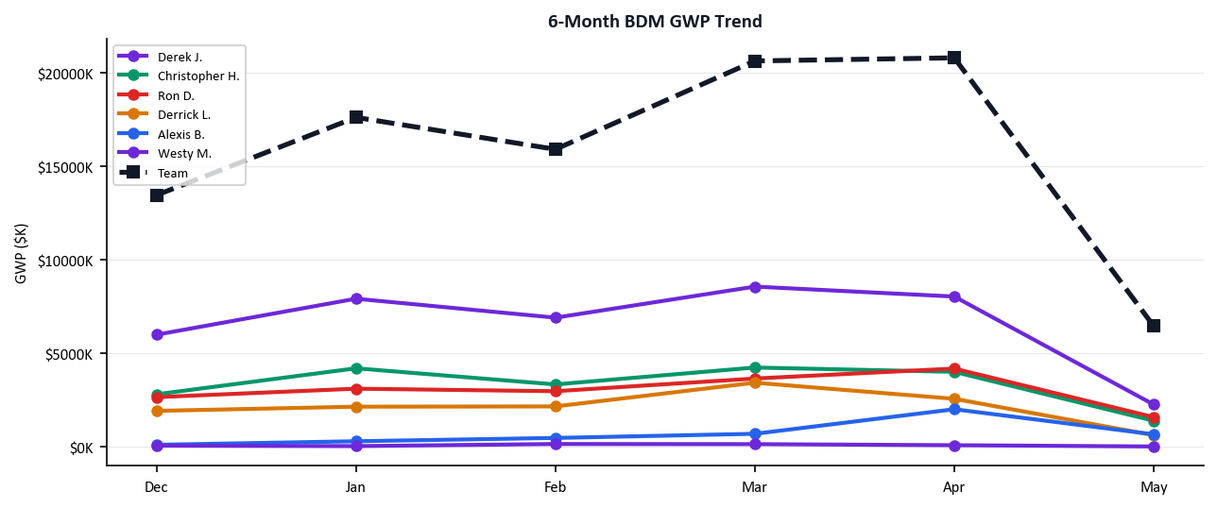
Q2 Forecast & Trends
Generated May 12, 2026
6-Month GWP Trend · Q2 Goal Gap per Rep · BDA→BDM Pipeline | As of May 12, 2026
Q2 GOAL GAP PER BDM
Rep
Q2 Goal
Q2 YTD
Gap
Proj. Q2
Status
Derek J.
$26.1M
$10.3M
$15.9M
$22.3M
At Risk
Christopher H.
$12.7M
$5.4M
$7.3M
$11.6M
At Risk
Ron D.
$12.0M
$5.7M
$6.2M
$12.4M
On Track
Derrick L.
$10.0M
$3.2M
$6.8M
$6.8M
Behind
Alexis B.
$1.8M
$2.6M
$-864102
$5.7M
On Track
Westy M.
$870K
$67K
$802K
$146K
Behind
BDA→BDM PIPELINE — Agencies with both a BDA (onboarding) and BDM (owner) assignment
Agency
BDA (Onboarding)
BDM (Owner)
Q1 GWP
Q2 GWP
Status
Vantage Ins Llc
Portia Lewis
Ron Douglas
$396K
$218K
Active
Dream Assurance Llc
Kurt Butterfield
Derrick Leroy
$80K
$58K
Active
Xgen Insurance Group Llc
Kurt Butterfield
Derrick Leroy
$91K
$23K
Active
ECO INSURANCE SERVICES
Kurt Butterfield
Derrick Leroy
$18K
$27K
Active
Danaco Group
Kurt Butterfield
Derrick Leroy
$19K
—
Warm
Cobic Inc. Dba Cm Insurance Agency
Kurt Butterfield
Derrick Leroy
—
—
Developing
Marketers General Insurance Agency, Inc.
Kurt Butterfield
Derrick Leroy
—
—
Developing
Notes:
PURPOSE
This slide answers "where are we headed?" — showing GWP trajectory by rep, how far each BDM is from their Q2 goal, and how the BDA-to-BDM pipeline is converting.
WHAT TO LOOK FOR
- 6-Month GWP Trend (top chart): look for reps whose lines are flattening or declining over the past two months — that's a warning before it shows up in the quarterly number. An upward slope means momentum.
- Q2 Goal Gap table: the Gap column shows exactly how much revenue each rep still needs to write to hit their Q2 goal. Projected Q2 column shows where they're likely to land if current pace holds.
- BDA-to-BDM Pipeline (bottom section): this shows agencies that a BDA has onboarded and a BDM now manages. Active = already generating Q2 revenue. Warm = produced in Q1 but quiet so far in Q2. Developing = no revenue yet. "Warm" agencies are the nearest-term opportunity.
- Any rep with a large Gap and a flat or declining trend line needs a specific plan, not just encouragement.
COLUMN GUIDE (Q2 Goal Gap table)
- Q2 Full Goal: the rep's full-quarter revenue target.
- Q2 YTD: actual GWP written in Q2 so far.
- Gap: how much more revenue is needed to hit the goal.
- Proj. Q2: pace-adjusted projection for where they will finish if current rate holds.

Slide 12
Activity Intelligence — Touches to Premium
Generated May 12, 2026
Q2 YTD | Apr 1–May 12 | All Reps | Activity = Calls Out + Meetings | Binds = policies written | GWP pace-adjusted for partial month
SECTION 1 — ACTIVITY CONVERSION FUNNEL (Activities → Quotes Submitted → Binds → GWP Written)
Rep
Role
Q2 Comp%
Acts/Wk
Q2 Subs
Q2 Binds
Bind Rate
Avg GWP/Bind
Acts per Bind
GWP per Activity
Derek J.
BDM
100%
64.0
5,472
415
8%
$25K
1
$31,502
Derrick L.
BDM
100%
53.6
2,470
197
8%
$16K
1
$11,267
Cameron B.
BDA
60%
47.4
712
36
5%
$27K
7
$3,994
Taylor S.
BDA
50%
43.8
436
15
3%
$19K
12
$1,580
Westy M.
BDM
20%
33.4
147
6
4%
$11K
29
$388
Portia L.
BDA
25%
32.5
1,190
27
2%
$28K
5
$5,822
Christopher H.
BDM
40%
32.2
2,636
272
10%
$20K
1
$31,776
Ron D.
BDM
40%
28.2
4,213
238
6%
$24K
1
$40,150
Erika C.
BDA
0%
20.5
2,078
41
2%
$13K
2
$6,258
Kurt B.
BDA
0%
8.0
3,054
77
3%
$26K
1
$37,686
Alexis B.
BDM
0%
7.2
1,400
110
8%
$24K
1
$45,557
SECTION 2 — PORTFOLIO ENGAGEMENT (left) · EFFICIENCY vs RESULTS (right, sorted high→low GWP/Activity)
Rep
Portfolio
Active Q1
Dormant%
GWP / Active Agency
Rep
Q2 Comp%
GWP YOY%
GWP per Activity
Signal
Derek J.
53
53
0%
$194K
Alexis B.
0%
+396.7%
$45,557
Efficient
Derrick L.
30
28
7%
$113K
Ron D.
40%
+109.0%
$40,150
Efficient
Cameron B.
48
47
2%
$21K
Kurt B.
0%
+145.5%
$37,686
Efficient
Taylor S.
26
25
4%
$11K
Christopher H.
40%
+69.0%
$31,776
Efficient
Westy M.
14
11
21%
$6K
Derek J.
100%
+49.4%
$31,502
Converting
Portia L.
53
45
15%
$17K
Derrick L.
100%
+17.6%
$11,267
Converting
Christopher H.
45
45
0%
$119K
Erika C.
0%
+1474.5%
$6,258
Efficient
Ron D.
35
34
3%
$169K
Portia L.
25%
+1353.3%
$5,822
Efficient
Erika C.
42
41
2%
$13K
Cameron B.
60%
+2.3%
$3,994
Efficient
Kurt B.
42
41
2%
$49K
Taylor S.
50%
+60.4%
$1,580
Efficient
Alexis B.
22
22
0%
$120K
Westy M.
20%
-48.8%
$388
At Risk
KEY INSIGHTS
Best Converter
Biggest Portfolio Unlock
Compliance → GWP Signal
Portia L. leads at $28K per bind (27 binds, 5 acts/bind). Sets team benchmark for conversion quality.
Portia L. has 8 dormant agencies (15% of portfolio). At $17K/active agency, 10% reactivation adds meaningful pipeline.
Top-3 compliant reps avg GWP YOY +23.1% vs bottom-3 at +672.2%. Compliance does NOT track with GWP output this Q. Activity discipline is a leading indicator — use it to forecast rep trajectory.
Notes:
PURPOSE
This is the efficiency deep-dive — it shows not just whether reps are active, but whether their activity is converting into revenue. Use this slide to identify who is working smart vs. who is working hard without results.
WHAT TO LOOK FOR
- Acts per Bind: how many calls and meetings does it take for each rep to write one policy? A very high number means lots of effort with low conversion — the issue might be prospect quality, not effort.
- GWP per Activity: how many dollars of premium does each touch generate on average? Higher is better. Compare reps in the same role.
- Signal quadrant (Section 2 right side): the most actionable column on this slide.
- "Converting" = high activity AND strong GWP growth. This rep is doing everything right.
- "Qual Gap" = high activity but GWP declining. They're making the calls but something is wrong with what they're pitching or who they're calling.
- "Efficient" = lower activity but GWP is growing. Lucky or smart — worth understanding why.
- "At Risk" = low activity AND declining GWP. This is the urgent intervention category.
- Auto-generated insight boxes at the bottom surface the three most important data-driven callouts for the week.
COLUMN GUIDE (Section 1 — Conversion Funnel)
- Q2 Comp%: percentage of Q2 weeks the rep hit their activity goal.
- Acts/Wk: average weekly activities (calls + meetings) in Q2.
- Q2 Subs / Q2 Binds: total quotes submitted and policies bound in Q2.
- Bind Rate: binds divided by submissions — what percentage of quotes result in a policy.
- Avg GWP/Bind: average premium per policy written.
- Acts per Bind: total activities divided by total binds — the "cost" in touches to write a policy.
- GWP per Activity: total Q2 GWP divided by total activities — revenue generated per touch.

Slide 13
APPENDIX
Q1 2026 Final Reference Slides
Historical context — BDM + BDA Q1 Performance Matrices | Q1 Activity Dashboard

Slide 14
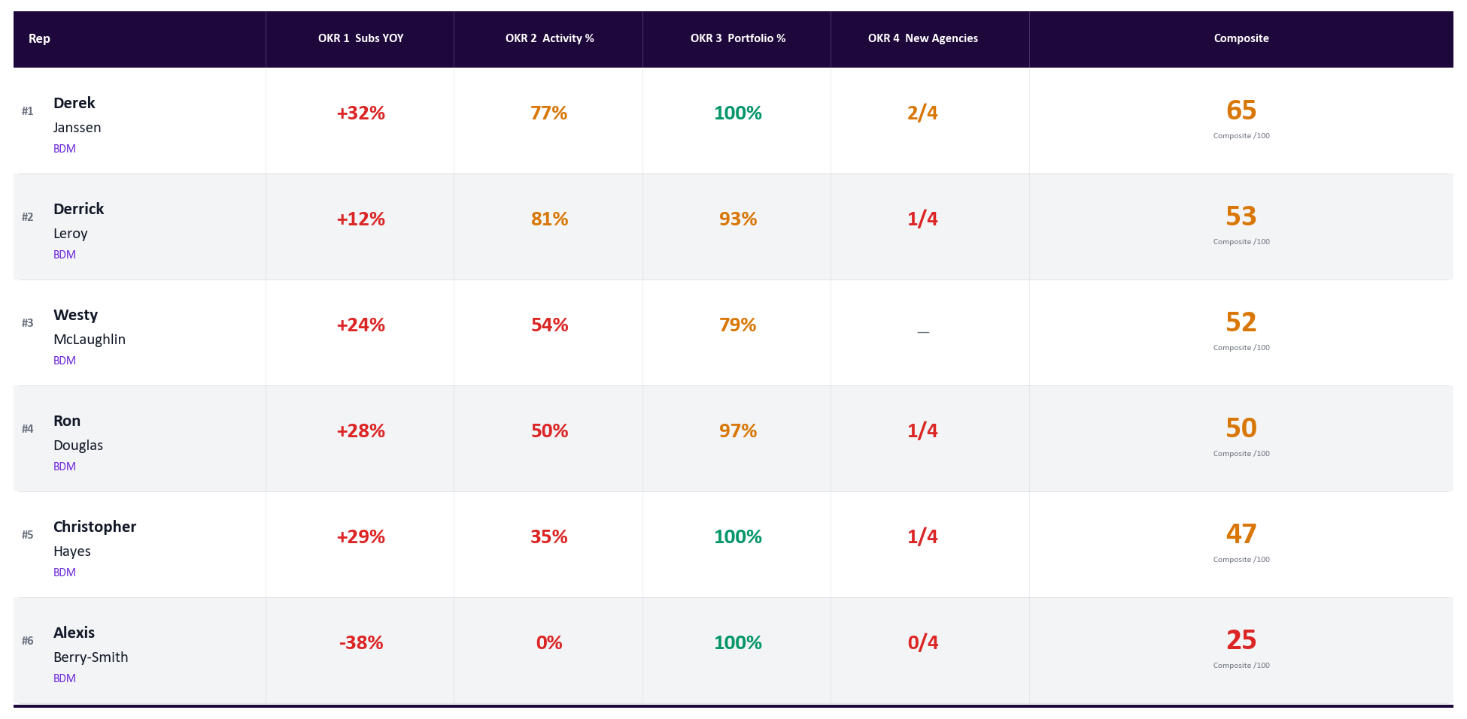
BDM Performance Matrix — Q1 2026 Final
Generated May 12, 2026
Jan 1 – Mar 31, 2026 | Completed Quarter | Green = on target | Amber = at risk | Red = behind | Goal: ≥40 acts/wk
Notes:
PURPOSE
This is the completed Q1 scorecard for BDMs — the definitive, final result for January through March 2026 with no adjustments needed.
WHAT TO LOOK FOR
- These are locked final scores — use this as the baseline when discussing Q2 progress on the live matrix slide.
- Any BDM who finished Q1 in red on multiple OKRs is likely still carrying that deficit into Q2.
- Compare individual Q1 scores to the Q2 matrix to identify who is improving and who is sliding.
- OKR 4 (new agencies) is especially important here — reps who missed Q1 need to catch up, not just keep pace.

Slide 15
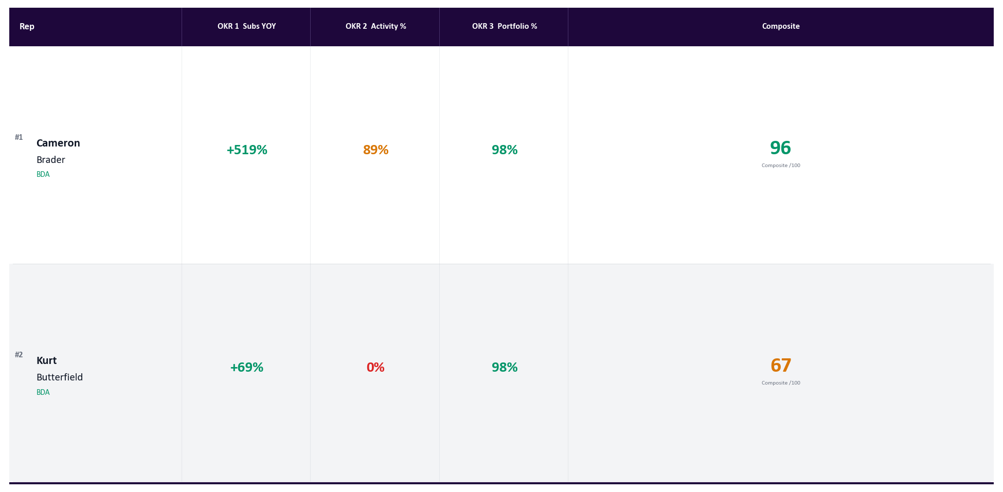
BDA Performance Matrix — Q1 2026 Final
Generated May 12, 2026
Jan 1 – Mar 31, 2026 | Completed Quarter | Green = on target | Amber = at risk | Red = behind | Goal: ≥50 acts/wk
Notes:
PURPOSE
This is the completed Q1 scorecard for BDAs — the definitive, final result for January through March 2026.
WHAT TO LOOK FOR
- BDA Q1 final scores show who started Q2 from a position of strength versus who is playing catch-up.
- BDA goals: Subs +50% YOY, Activity 50 acts/wk, Portfolio 70% active.
- Use this alongside the live Q2 BDA matrix to discuss trajectory — is each BDA tracking better or worse than where they finished Q1?
- BDAs who were consistently red in Q1 and have not shown improvement early in Q2 need a structured development plan, not just a coaching conversation.

Slide 16
Activity Dashboard Q1 Final — Calls + Meetings
Generated May 12, 2026
Jan 1 – Mar 31, 2026 | Completed Quarter | All Reps | BDM: 40/wk • BDA: 50/wk
Rep
January
February
March
Overall
Leroy
65% to goal
77% to goal
96% to goal
81%
Derrick
104
123
192
Janssen
76% to goal
28% to goal
117% to goal
77%
Derek
121
45
234
McLaughlin
38% to goal
74% to goal
50% to goal
54%
Westy
60
119
101
Douglas
38% to goal
60% to goal
52% to goal
50%
Ron
60
96
103
Hayes
34% to goal
34% to goal
36% to goal
35%
Christopher
54
54
72
Berry-Smith
0% to goal
0% to goal
0% to goal
0%
Alexis
0
0
0
BDAs — Business Development Associates (goal: 50 acts/wk)
Brader
104% to goal
95% to goal
73% to goal
89%
Cameron
208
190
183
Cabrera
0% to goal
0% to goal
0% to goal
0%
Erika
0
0
0
Lewis
0% to goal
0% to goal
0% to goal
0%
Portia
0
0
0
Sloan
0% to goal
0% to goal
0% to goal
0%
Taylor
0
0
0
Butterfield
0% to goal
0% to goal
0% to goal
0%
Kurt
0
0
0
Notes:
PURPOSE
Appendix reference showing the completed Q1 activity record for all reps — useful context when discussing whether Q2 activity levels represent improvement or regression.
WHAT TO LOOK FOR
- These are final, closed-quarter numbers — no pace adjustment. What you see is what happened in Q1.
- Compare any rep's Q1 Avg % to their current Q2 Avg % to determine if their discipline is improving.
- Reps who were green all quarter in Q1 set a high bar — are they sustaining that in Q2?
- Reps who were frequently red in Q1 and are starting Q2 the same way have a behavioral pattern, not just a bad week.

Slide 17
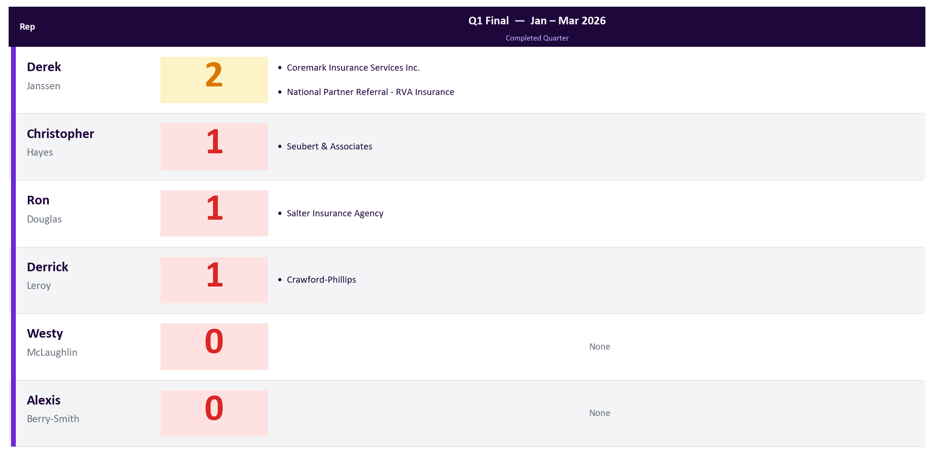
New Producing Agencies | Q1 2026 Final
Generated May 12, 2026
BDMs Only | Completed Quarter | Jan 1 – Mar 31, 2026 | Appendix Reference
Notes:
PURPOSE
Appendix reference showing the final Q1 2026 new agency count per BDM — a completed quarter with no pace adjustments.
WHAT TO LOOK FOR
- Use this to benchmark Q2 progress: if a BDM got 3 new agencies in Q1, are they on pace for 4 in Q2?
- Reps who hit the goal in Q1 (green) should be asked what worked. Reps who missed (red) need a different approach in Q2.
- Agency names listed are the actual new partners brought in during Q1 — useful for tracking which relationships are maturing into Q2 production.

